Slide 1

Road Sign & Road State Mobile App

Slide 2

GROUP 3
Task 2

Slide 3
REQUIREMENTS GATHERING
Process of collecting and documenting stakeholder needs and expectations.
Objective: Identify user and system requirements for system incorporation.

Slide 4


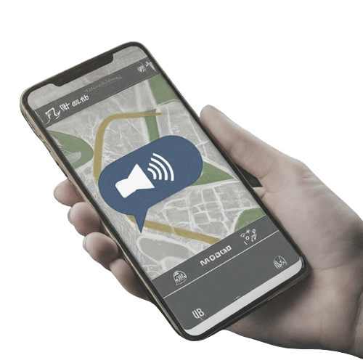
Functional
requirements
Functional
requirements
Functional
requirements
D
Non-functional requirements
C
Responsiveness
Accuracy
Usability
Offline functionality
Accessibity
Performance
User requirements
Integrate with Navigation
B
Road Sign Recognition
View Road Signs
A
Road Condition Alerts
Location Tracking
Customize Notifications
Distance: 200 m
Report Incidents
Voice Notifications
Customize notifications
Receive Real-time Alerts

Slide 5


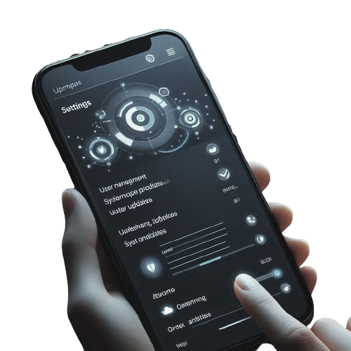
Non-functional requirements
Functional requirements
Functional
requirements
D
Additional Considerations
C
Manage Road sign Database
Security
Multilingual Support
Community features
Monetization strategies
Gamification
Partnerships
Educational Content
Admin requirements
B
User Management
Scalability
A
Publish Road State Updates
Data Analytics
Reliability
Maintainability
System Updates
Analyse User Reports

Slide 6
Thanks for your attention

